Slide 1
Flow Charts
Programing Fundamentals

Slide 2
Flow Charts &Its Types
A flowchart is a type of diagram that represents an algorithm, workflow or process. The flowchart shows the steps as boxes of various kinds, and their order by connecting the boxes with arrows. This diagrammatic representation illustrates a solution model to a given problem.
The Process Flowchart or Communication Flow Chart. separate steps of a process in sequential order
The Workflow Chart or Workflow Diagram. visual layout of a process
The Swim lane Flowchart. (that show a process from start to finish)
The Data Flowchart. a graphical or visual representation using a standardized set of symbols and notations to describe a business's operations through data movement.

Slide 3
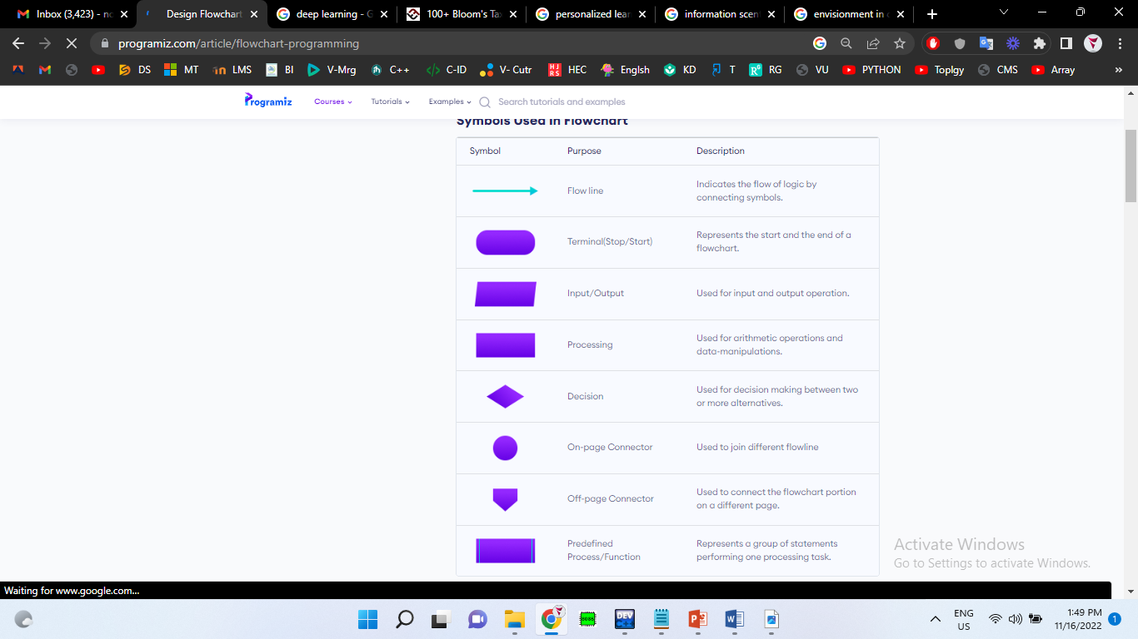
Symbols in Flow Chart

Slide 4
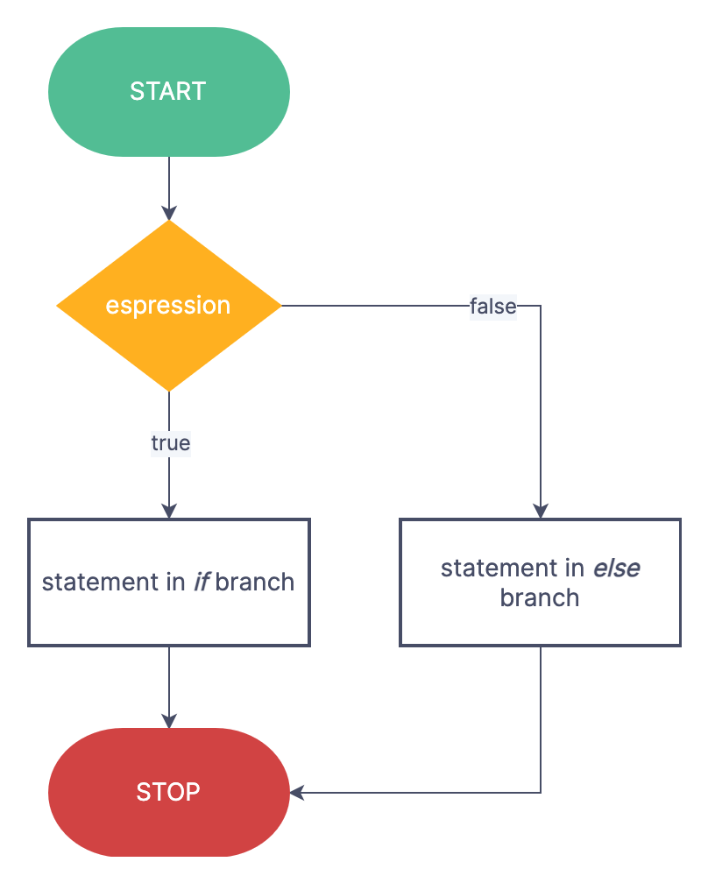
IF-EELSE
IF
TRUE
Expression(s)
statement(s)
False

Slide 5
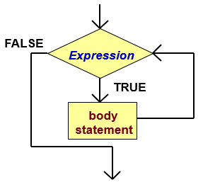
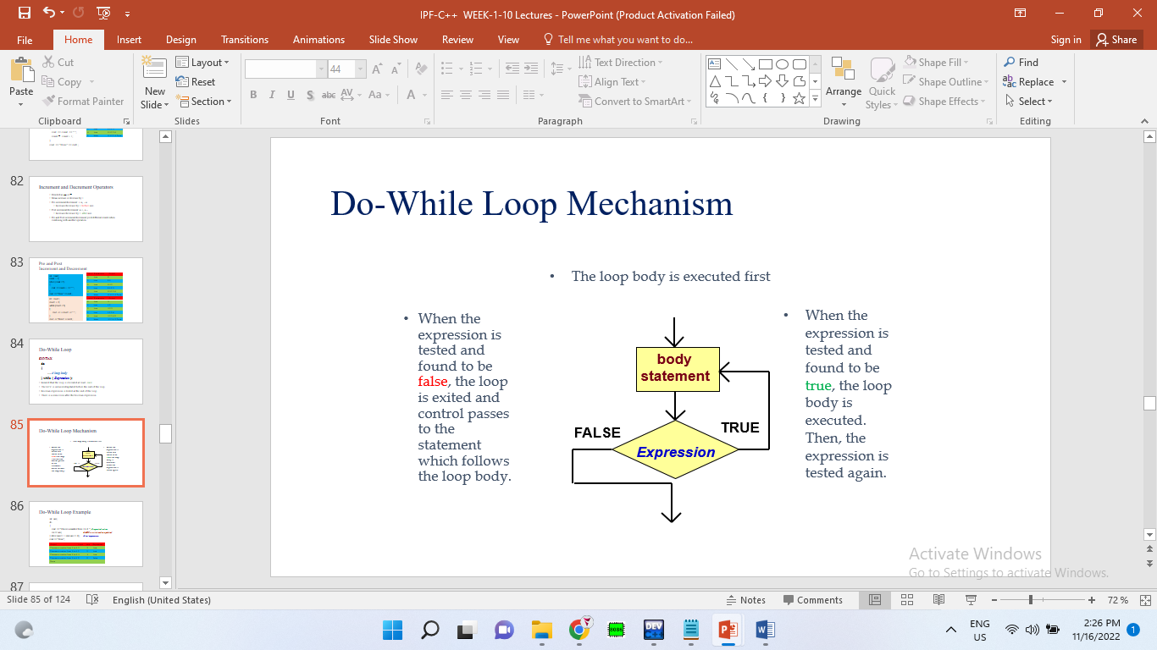
WHILE LOOP
Do-While Loop

Slide 6
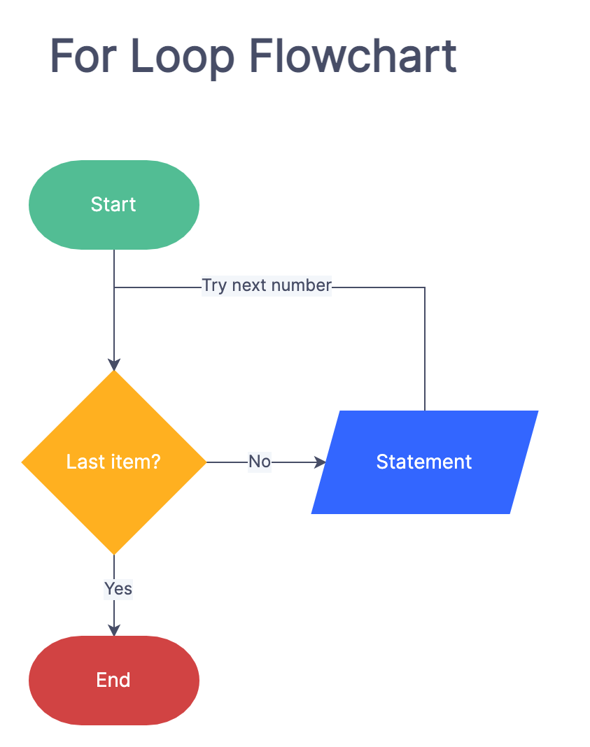

Slide 7
switch Multiple-Selection Structure
true
case a
case a action(s)
break
false
case b
true
case b action(s)
break
false
.
.
.
case z
true
case z action(s)
break
false
default action(s)

Slide 8
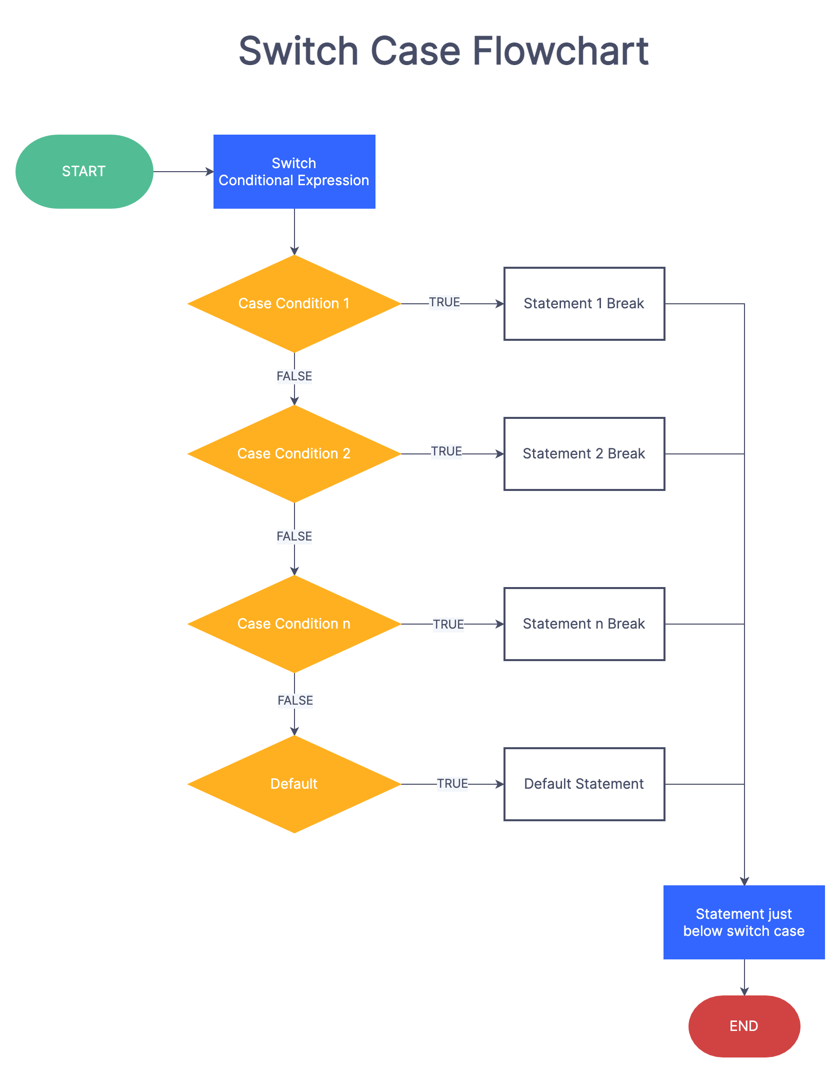

Slide 9
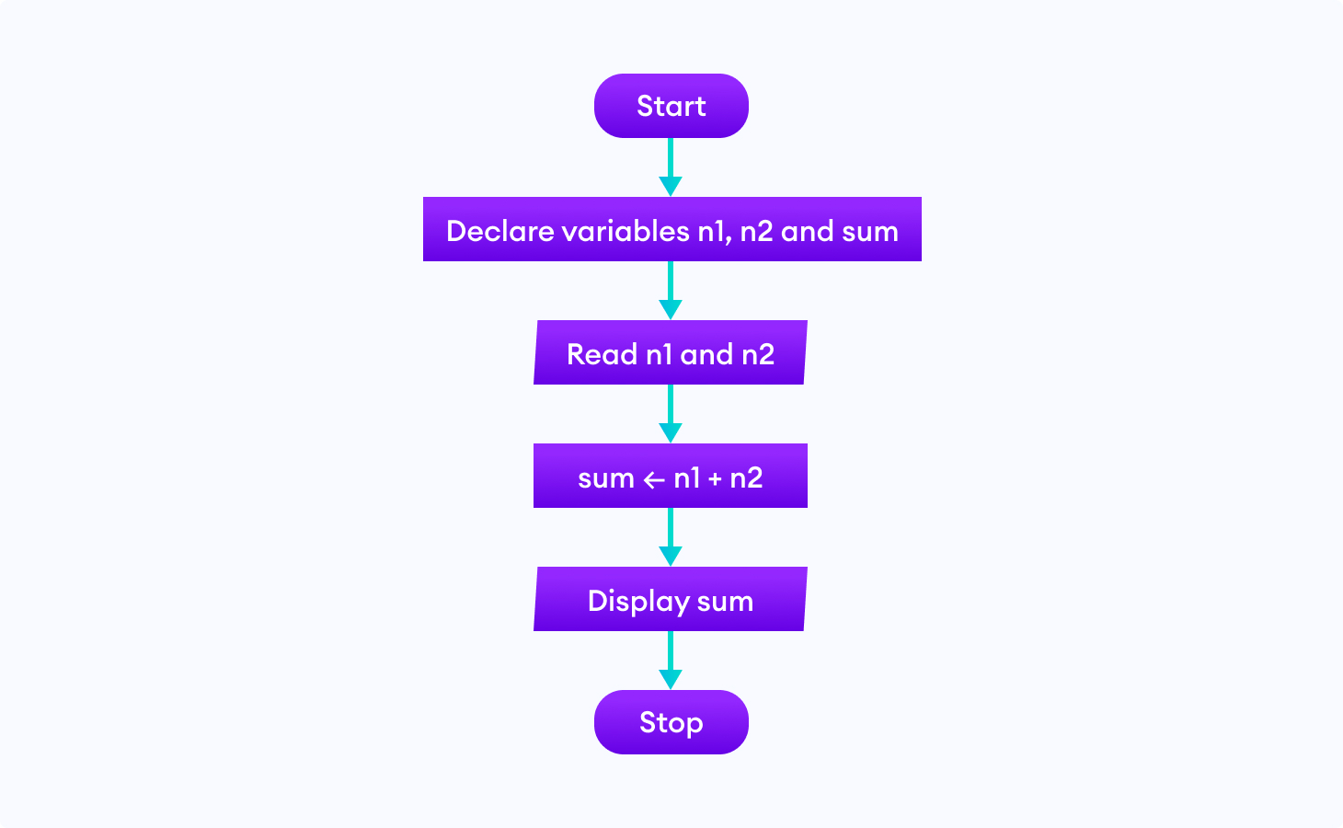
Examples of flowcharts in programming
1. Add two numbers entered by the user.

Slide 10
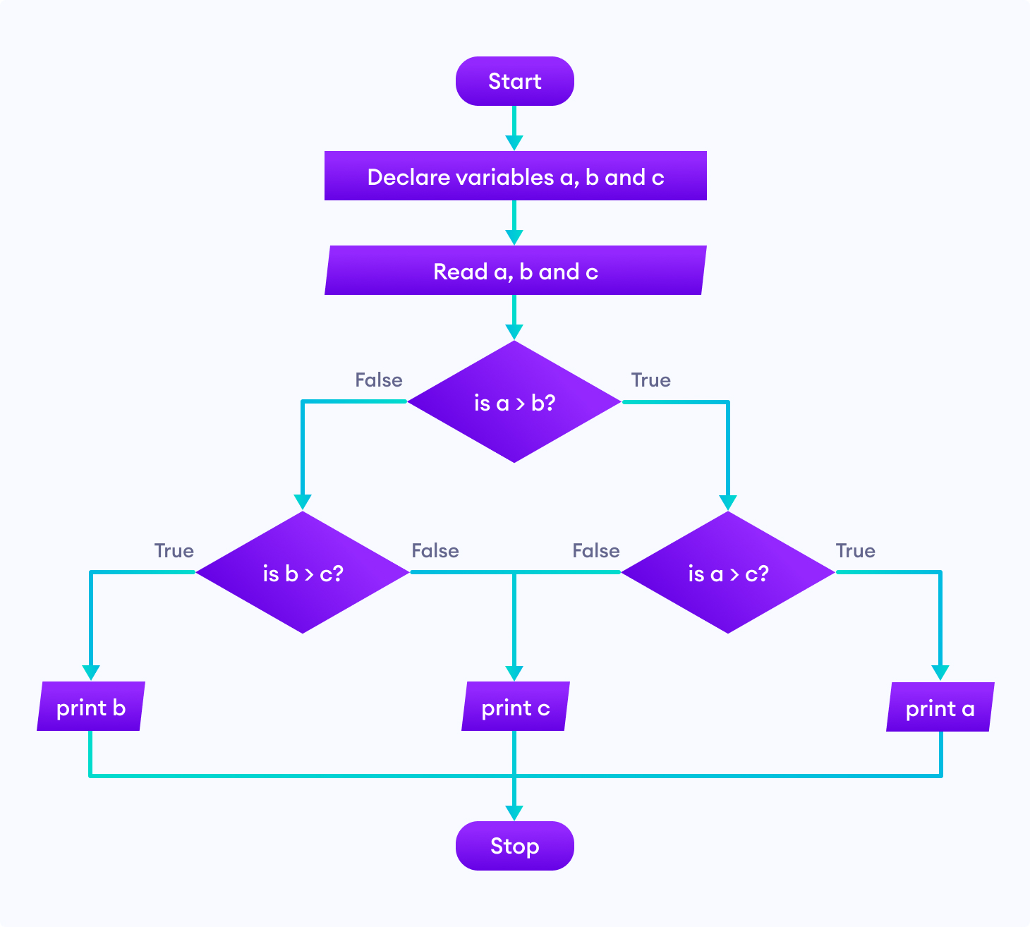
Find the largest among three different numbers entered by the user.

